Slide 1
Digital Portfolio
STUDENT NAME: KRISHNA KUMAR.B
REGISTER NO AND NMID:212405636 and asunm1719212405636
DEPARTMENT:BCA
COLLEGE :PERI COLLEGE OF ARTS AND SCIENCE

Slide 2
PROJECT TITLE
STUDENT DIGITAL PORTFOLIO

Slide 3
AGENDA
1. Problem Statement
2.Project Overview
3.End Users
4.Tools and Technologies
5.Portfolio design & Layout
6.Feautures & Functionality.
7.Results & Screenshot .
8.Conclusion.
9.Github Link

Slide 4
Problem Statement
Without a structured digital portfolio system:
Students struggle to demonstrate their competencies beyond grades and certificates.
Teachers and mentors lack a centralized tool to evaluate student progress over time.

Slide 5
Project Overview
“The Student Digital Portfolio is a dynamic platform that empowers learners to showcase their academic achievements, skills, and personal growth in an interactive and professional way, bridging the gap between traditional records and modern digital presentation.”

Slide 6
Who Are The End Users?
Designed for students to showcase growth, educators to track progress, and parents to witness achievements—all in one seamless platform.

Slide 7
Tools And Techniques
🛠 Tools
1. CodePen – For building and showcasing small front-end projects (HTML, CSS, JS).
2. GitHub – For storing code, tracking versions, and sharing projects.
3. GitHub Pages – Free hosting service to publish a personal portfolio website.
4. Google Drive / OneDrive – To store certificates, documents, and project reports.
Techniques
1. Organize Projects Clearly – Showcase work by category with short descriptions.
2. Showcase Live Demos – Embed CodePen projects or use GitHub Pages for previews.
3. Maintain Consistency – Use a clean, uniform design (fonts, colors, layout).
4. Highlight Skills & Reflections – Link projects to skills and share learning outcomes.
5. Keep it Updated – Add new projects, achievements, and improvements regularly.

Slide 8
🎨 Portfolio Design And Layout
1. Simple & Clean Layout – Avoid clutter; use whitespace for readability.
2. Consistent Theme – Stick to a limited set of colors, fonts, and styles.
3. Clear Navigation – Use a top menu or sidebar (About, Projects, Skills, Contact).
4. Highlight Projects First – Make the portfolio project-centered with thumbnails or cards.
5. Responsive Design – Ensure it looks good on mobile, tablet, and desktop.
6. Readable Typography – Use easy-to-read fonts and maintain proper hierarchy (headings vs. body text).
7. Visual Balance – Use grids or sections to align text, images, and code embeds.
8. Interactive Elements – Add buttons, hover effects, or project previews for engagement.
9. Personal Branding – Include a logo, photo, or tagline to make it unique.
10. Quick Access to Contact Info – Place links to email, LinkedIn, or resume in a visible spot.

Slide 9
Features And Functionality
1. Project Showcase – Ability to display projects with descriptions, images, live demos, and links to source code.
2. Interactive & Accessible – Responsive design, easy navigation, and multimedia support (videos, embeds, documents).
3. Professional Connectivity – Integrated contact section with links to email, LinkedIn, GitHub, or resume.

Slide 10
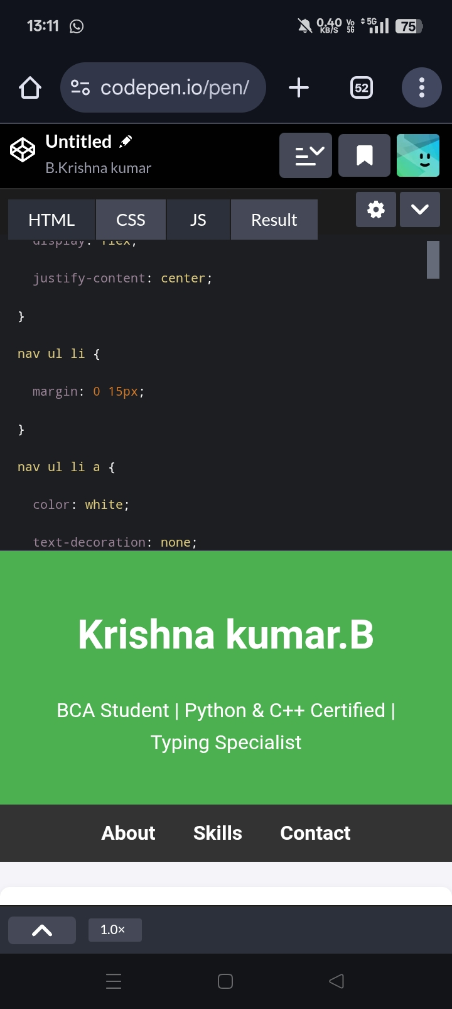
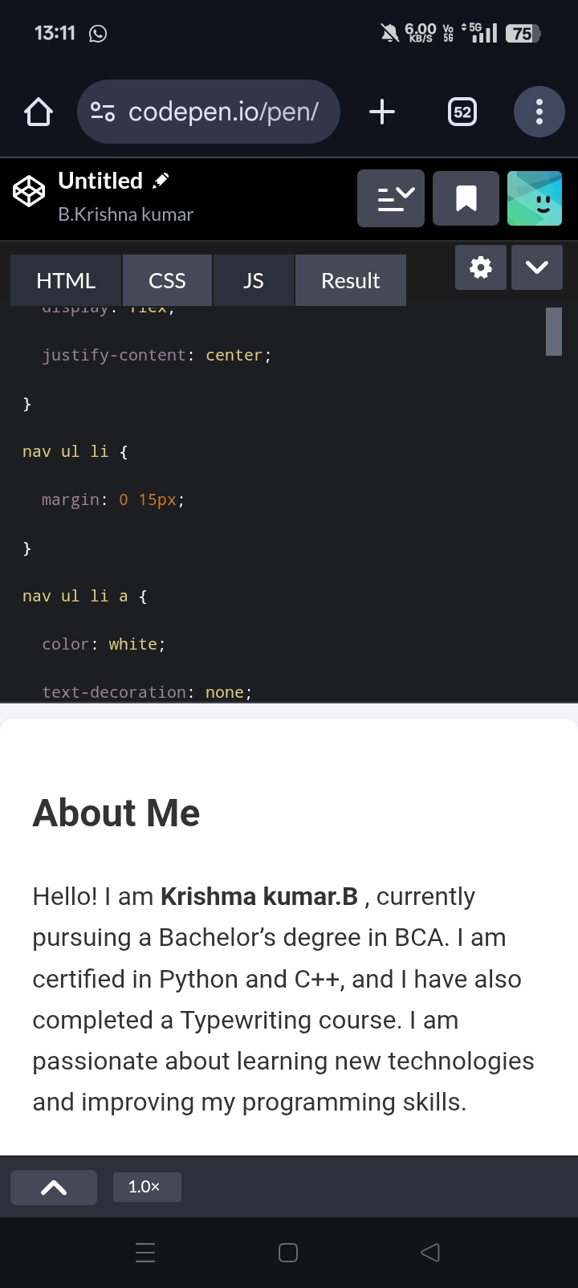
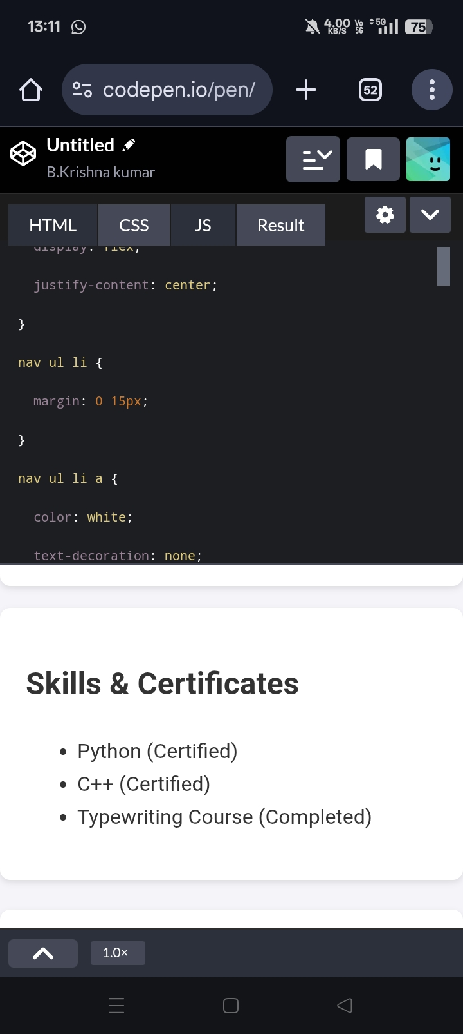
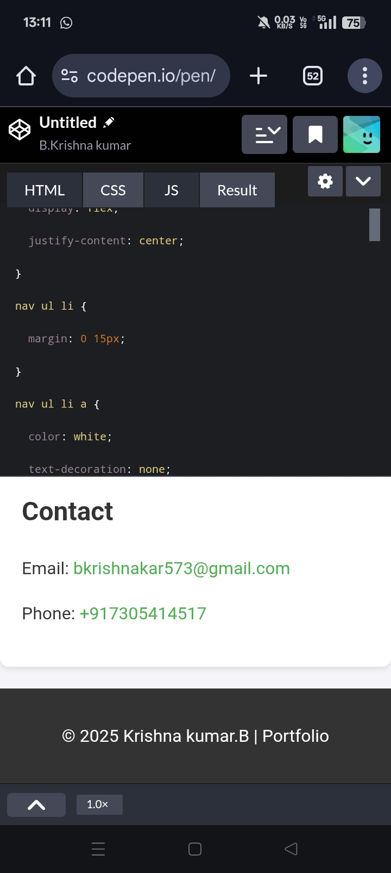
Results And Screenshots

Slide 11
GitHub link
https://github.com/bkrishnakumar573-beep/B.Krishna-kumar.git

Slide 12
Conclusion
This portfolio highlights my growth, skills, and creativity as a learner. It reflects my progress so far and my commitment to keep learning, improving, and taking on new challenges in the future.

